Slide 1
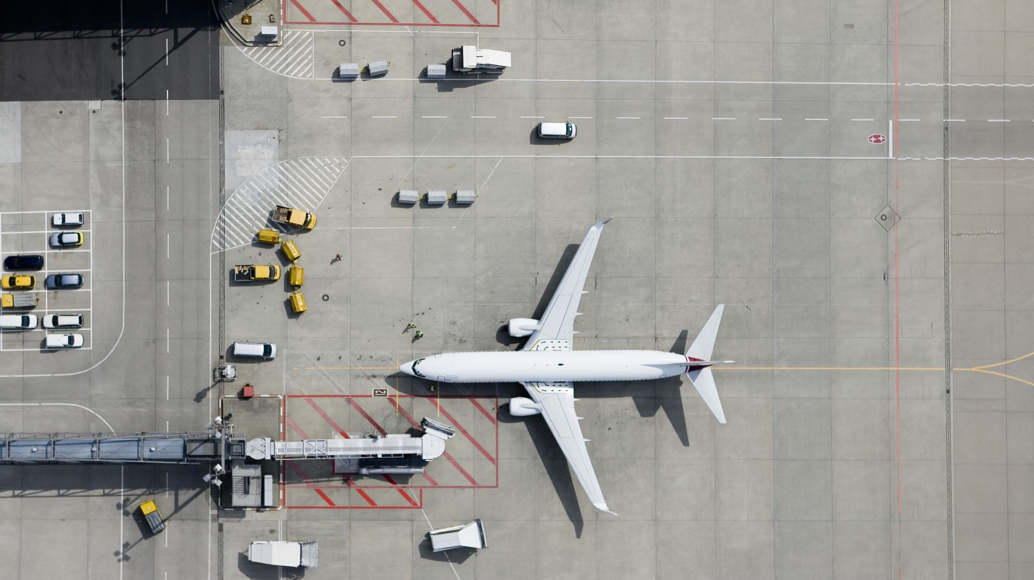
Automating Airports from curbside to Tarmac, and Beyond R.N.L.Chittitalli

Slide 2
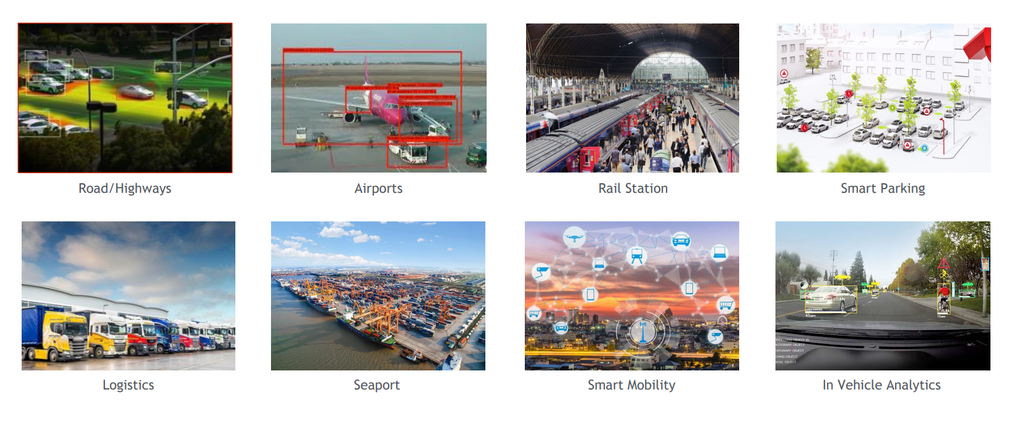
WHERE??

Slide 3
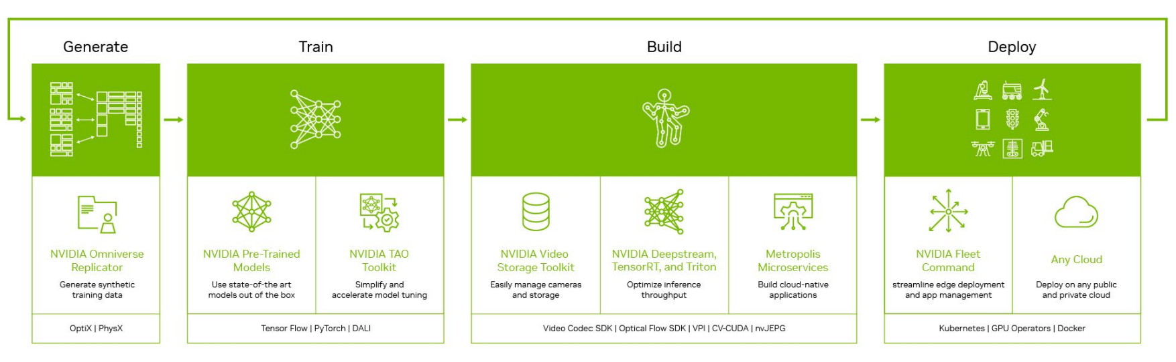
Measuring, understanding, detecting and predicting

Slide 4
For and how??
Safety and protection
Airside procedures
Terminal procedures
Landside operations
Curbside management
Traffic regulations

Slide 5
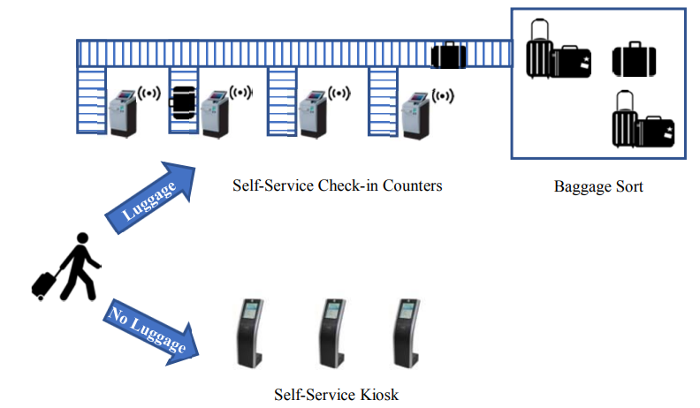
Automation of the Baggage Check-in Process
Internet of Things (IoT) concept to automate the check-in process as a self-service check-in counter where passengers use smart counters to check in their luggage
Smart counters used RFID (Radio-frequency identification) tags
Computer vision played as a security verification procedure
Reduces the time by 49%

Slide 6
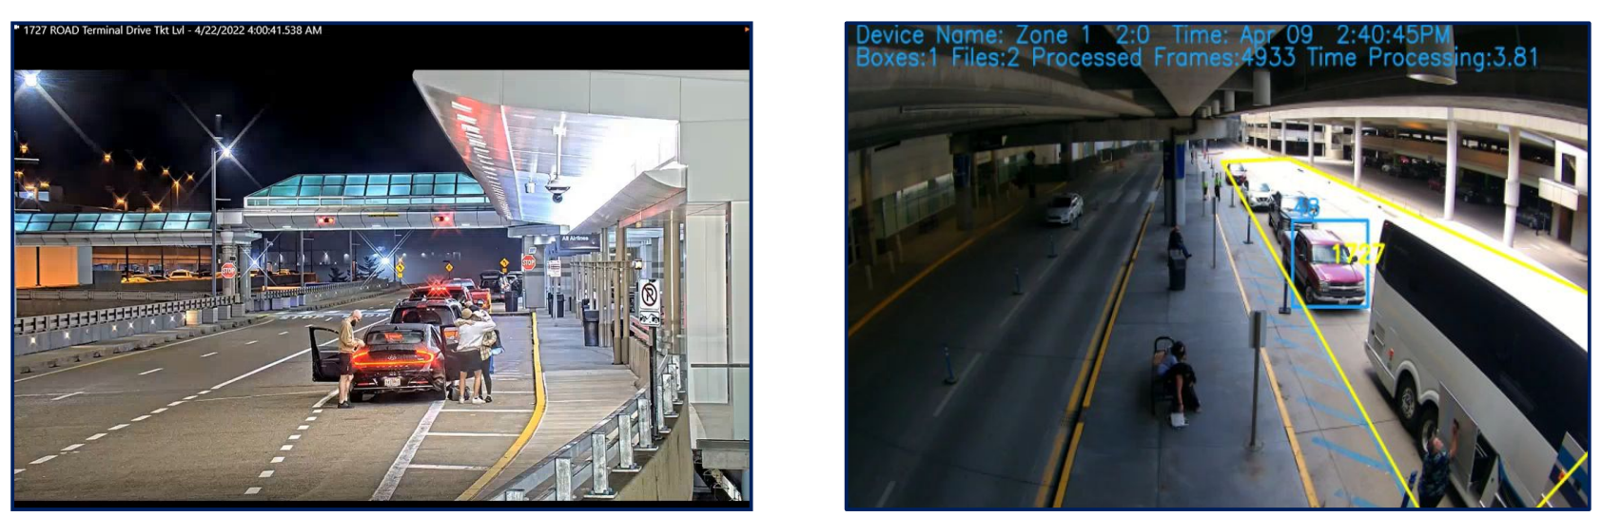
Al-based solution for curbside management
Innovative AI solutions for intelligent parking, traffic management, and retail sales.
Access real-time curb and street activity for freight, ride-hailing, delivery, and passenger vehicles, as well as for buses, e-scooters, bicycles, and pedestrians.
Improve overall guest experience
Ensure accurate billing by validating all Transportation Network Company (Ride Share Apps) activity.
Reduce wait times at drop-off and pick-up locations.
Detect, notify, and enforce common violations automatically.
Curbside traffic Curbside traffic with AI

Slide 7
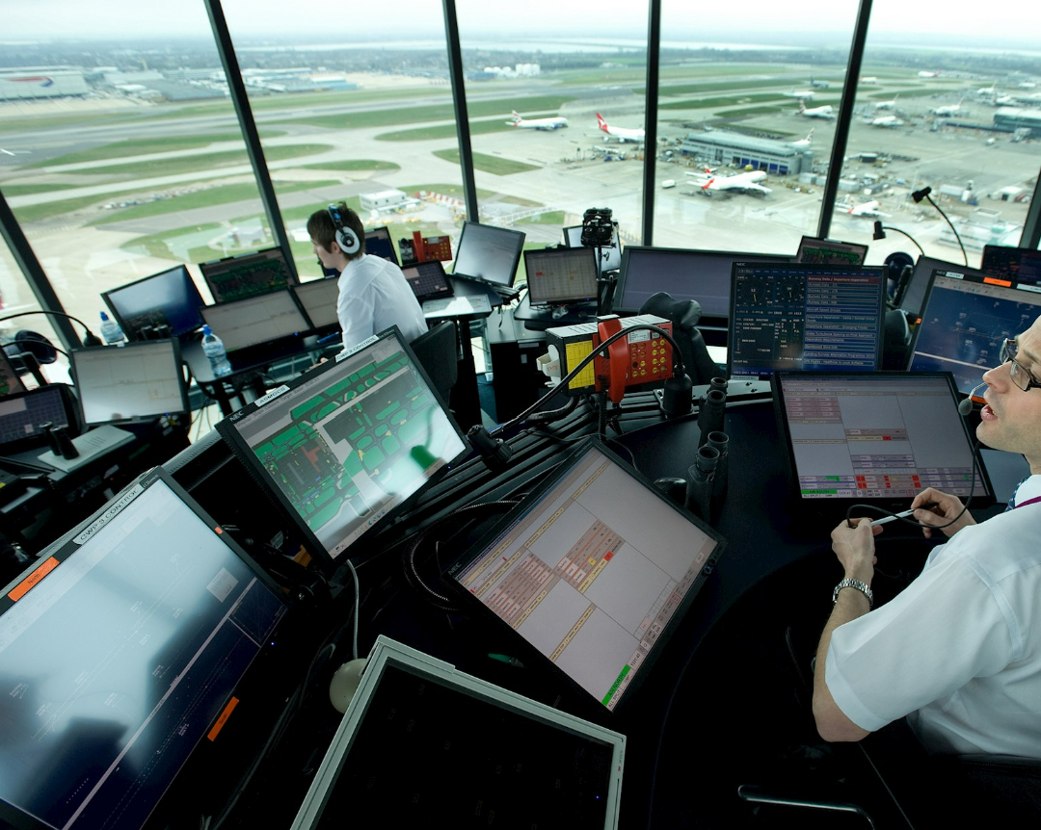
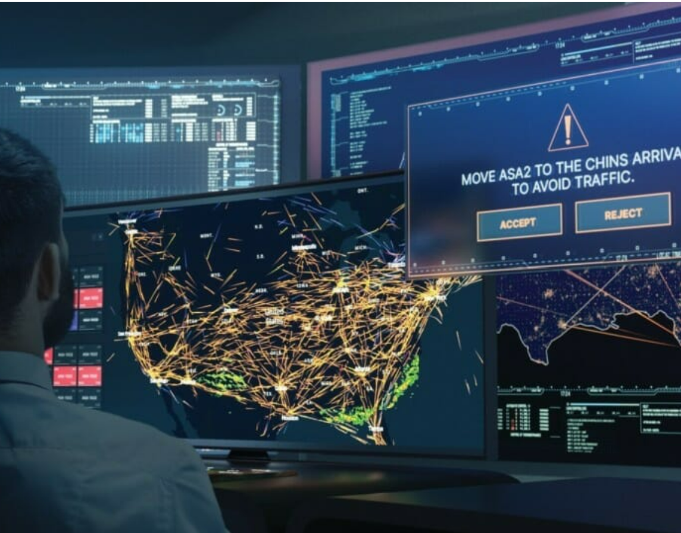
Al-based solutions for ATC and Airport efficiency
remote applications and remote tower services.
Using a flexible platform that offers a variety of proven, best-in-class technologies, each of which has been specifically selected and tailored to support the operational requirements, site, and constraints of the customer.
Digital Tower platform optimizes airport functionality and efficiency globally.

Slide 8
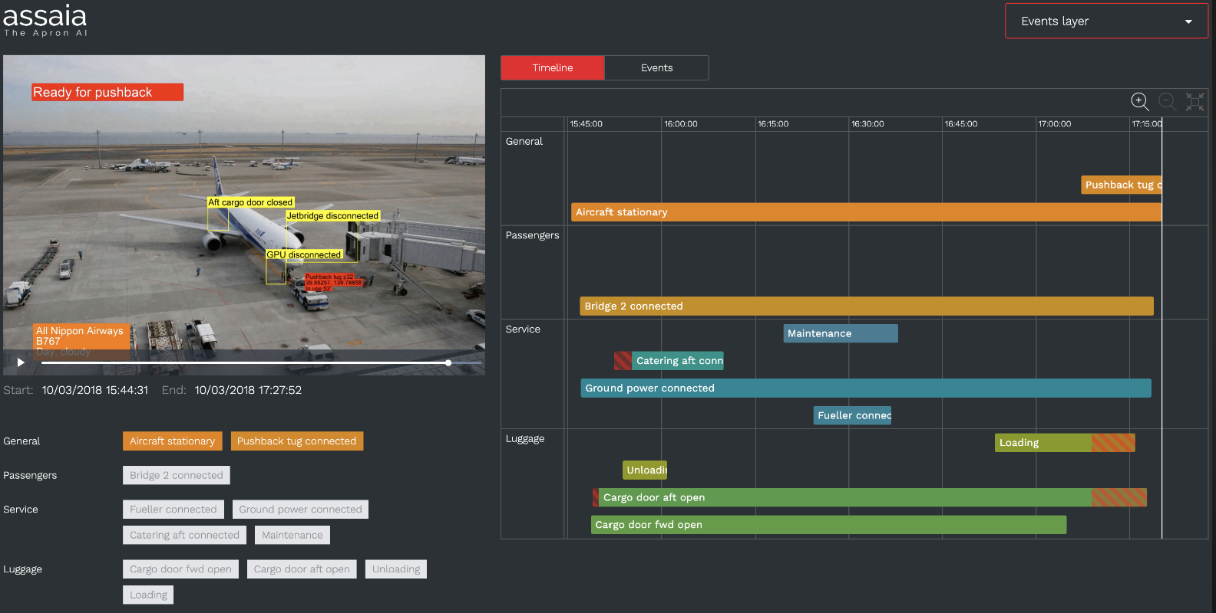
ASSAIA USES METROPOLIS TO IMPROVE AIRLINE AND AIRPORT OPERATIONAL EFFICIENCY
ASSAIA is a Swiss-based tech company that provides AI-powered solutions for airline and airport operations.
Metropolis is designed to improve operational efficiency and reduce costs by automating various processes and providing real-time insights and predictions.
ability to provide real-time predictions on aircraft turnaround times
also provides real-time insights on passenger flows, helping airports optimize terminal capacity and reduce congestion.

Slide 9
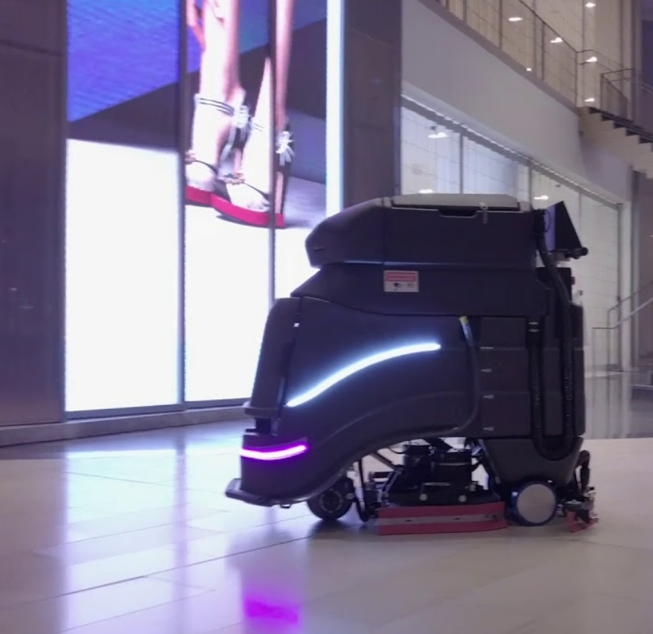
ADDING AI AUTOMATION TO CVG
CVG is the second largest air cargo carrier hub
One of the key areas where AI automation is being used is in baggage handling
CVG has also implemented AI-powered chatbots to help passengers navigate the airport and get information on flight status, baggage claim, and other services
CVG has partnered with a company called Avidbots to deploy autonomous cleaning robots that use AI algorithms to navigate the airport and clean floors and other surfaces

Slide 10
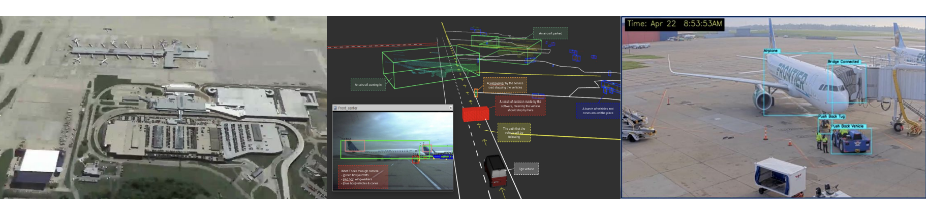
Automation is changing how our airports operates
Digital twin
ISV applications

Slide 11
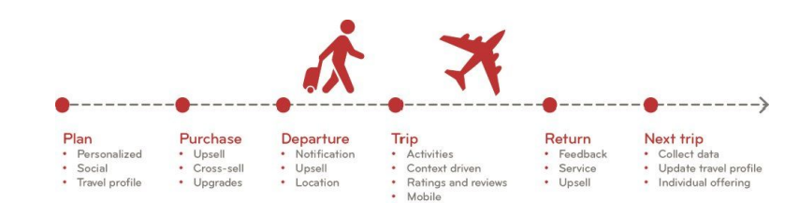
Making travelling experience better and easier
Continue to expand the advantages of Digital Twin
Continuous efforts to enhance sustainability and reduce carbon footprint.
Continue to serve as a global information source for smart spaces.
Create customized experiences for both customers and partners.

Slide 12
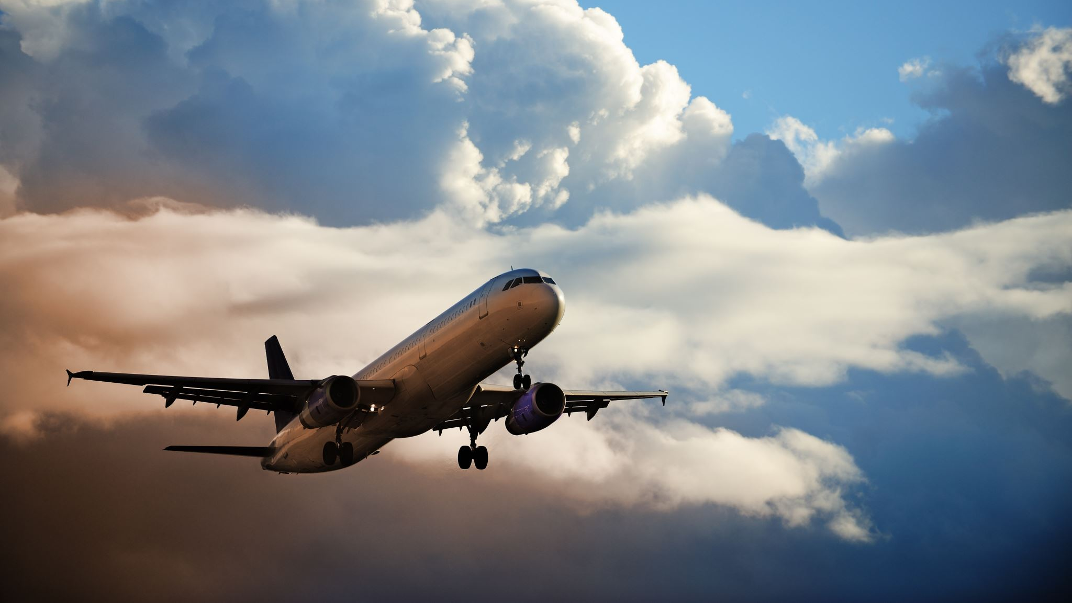
Thank you

